Slide 1
Module 3 Wireless Metropolitan and Local Area Networks
IEEE 802.16 (WiMax) – Mesh mode, Physical and MAC layer; IEEE 802.11(Wi-Fi) – Architecture, Protocol Stack, Enhancements and Applications.
Self-learning Topics:- WLL(Wireless Local Loop)

Slide 2

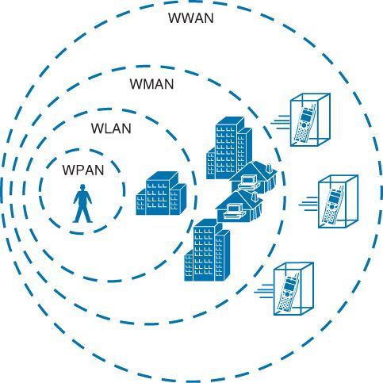
Wireless Metropolitan Area Networks(WMAN)
LEC1 Module4-4.1

Slide 3
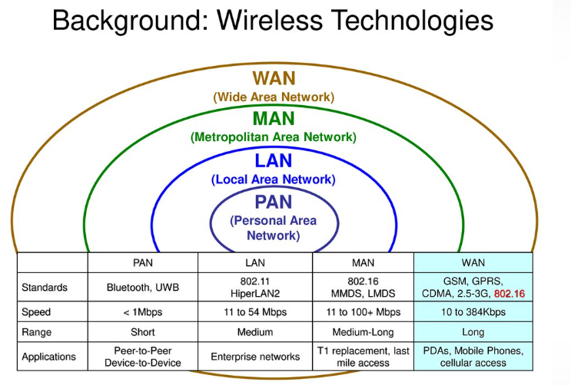

Slide 4
Wireless Metropolitan Area Networks
Metropolitan area networks (MANs) are large computer networks usually spanning a city.
They typically use wireless infrastructure or optical fiber connections to link their sites.
A MAN is optimized for a larger geographical area compared to local area network (LAN),ranging from several blocks of buildings to the entire city.
They can also depend on communication channels of moderate-to-high data rates.

Slide 5
A MAN might be owned and operated by a single organization, but it usually will be used by many individuals and organizations.
They might also be owned and operated as public utilities.
They often provide means for internetworking of local networks. MANs can span up to 50 km.
If wireless technology is used to connect the components in the MAN, then we call the network as wireless metropolitan area network (WMAN).

Slide 6
The wireless MAN (WMAN) is a promising broadband wireless access (BWA) technology that provides high-speed, high-bandwidth efficiency, and high-capacity multimedia services for both residential and enterprise applications
IEEE 802.16 standard known as worldwide interoperability for microwave access (AXcess) (WiMAX), promises to deliver last mile wireless broadband Internet access capable of carrying data intensive applications
Last mile: the final leg of the telecommunications networks that deliver services to retail end-users

Slide 7
WiMAX: WiMAX is defined as worldwide interoperability for microwave access by the WiMAX Forum, -June 2001 to promote conformance and interoperability of the IEEE 802.16 standard, officially known as Wireless MAN.
Some members of WiMAX(IEEE 802.16a) Forum are Airspan Networks, Alvarion, Aperto Networks, Ensemble Communication, Fujitsu of America, Intel, Nokia, Proxim, and Wi-LAN.
The Forum describes WiMAX as ‘‘a standards-based technology enabling the delivery of last mile wireless broadband access as an alternative to cable and digital subscriber line(DSL).’

Slide 8
WiMAX operates over licensed and non-licensed frequencies using non-line-of-sight (NLOS) and line-of-sight (LOS) technologies, extending broadband coverage to cities and towns wirelessly via a MAN.
In NLOS, a small antenna on the mobile unit is connected to the WiMAX tower.
In this mode, WiMAX uses a lower frequency range of 2–11 GHz (similar to Wi-Fi).
In LOS, a fixed dish antenna points straight at the WiMAX tower from a rooftop or a pole.
The LOS connection is stronger and more stable, so it is able to send a lot of data with fewer errors.

Slide 9
LOS transmissions use higher frequencies, with ranges reaching approximately 66 GHz.
WiMAX is designed to function as a carrier network, or a wireless Internet service provider (WISP), covering whole cities and regions with broadband Internet access.
the average cell ranges for most WiMAX networks have 4–5 mile range (in NLOS capable frequencies) even through tree cover and building walls.
Service ranges up to 10 miles (16 km) are very likely LOS applications.
Ranges beyond 10 miles are possible but may not be desirable for heavily loaded networks.

Slide 10
WiBro: In South Korea, mobile WiMAX is known as wireless broadband (WiBro).
WiBro is based on the same IEEE 802.16e-2005 standard as mobile WiMAX, but designed to be slightly more robust in terms of the subscriber’s speed compared with the base station (BS).
WiBro uses time-division duplex (TDD) only and a 8.75 MHz maximum channel bandwidth.
It uses the 2.3 GHz band, is interoperable with WiMAX equipment, and will compete with cable, digital subscriber loop (DSL), and wireless local area networks (WLANs) in South Korea.
WiMax1.25 MHz and 20 MHz in 2–11 GHz band

Slide 11
IEEE 802.16 Goal
To provide high-speed Internet access to home and business subscribers without wires.
It supports services such as voice over IP (VoIP), transmission control protocol/Internet protocol (TCP/IP) applications with different quality of service (QoS) requirements, etc.
Properties of IEEE 802.16
Some of the important properties of IEEE 802.16 are as follows:
1. It has broad bandwidth that supports up to 134 Mbps in 28 MHz channel (in 10–66 GHz air interface).

Slide 12
2. It supports multiple services and efficiently transports IPv4, IPv6, asynchronous transfer mode (ATM), Ethernet, etc.
3. It has media access control (MAC) designed for efficient use of spectrum which has comprehensive, modern, and extensible security.
4. It has point-to-multipoint topology (P2MP) with mesh extensions.
5. It supports adaptive antennas and space–time coding.
IEEE 802.16 Standards-(802.16a, 802.16c, 802.16d, 802.16e, and
802.16m)

Slide 13
Parameters | IEEE 802.16 | IEEE 802.16a | IEEE 802.16e
Spectrum | 10–66 GHz | 2–11 GHz | <6 GHz
Configuration | Line-of-sight | Non-line-of-sight | Non-line-of-sight
Bit rate | 32–134 Mbps (28 MHz channel) | ≤70 or 100 Mbps (20 MHz channel) | Up to 15 Mbps
Modulation | QPSK, 16-QAM, 64-QAM | 256 subcarrier OFDM using QPSK, 16-QAM, 64-QAM, 256-QAM | Same as 802.16a
Mobility | Fixed | Fixed | ≤75 Mph
Channel bandwidth | 20, 25, 28 MHz | Selectable 1.25–20 MHz | 5 MHz (planned)
Typical cell radius | 1–3 miles | 3–5 miles | 1–3 miles

Slide 14
IEEE 802.16 vs. IEEE 802.11
Parameter | IEEE 802.11 | IEEE 802.16 | Explanation
Range | 30–100 m | Typical cell size: 7–10 km; up to 50 km; no hidden stations. | 802.16 handles multipath propagation much better. Good signal quality in larger Distances
Target usage | Indoor | Outdoor; support of mesh topologies | 802.16 is used outdoor.
Scalability | Bandwidth of 20 MHz is fixed | Bandwidth between 1.5 and 28 MHz allows an adaptation to the users. | 802.16 has no problem with overlapping cells; usage of demand assignment multiple access (DAMA)–time division multiple access (TDMA) instead of CSMA/CA; adaptive modulation possible.

Slide 15
Contd…
Parameter | IEEE 802.11 | IEEE 802.16 | Explanation
Data rate | Up to 54 Mbps | Up to 134 Mbps, depending on assigned bandwidth | OFDM with higher modulation ratio; net data rate also is higher (due to DAMA)
QoS | Only with 802.11e | Differentiated services | Reservation of capacity allows several service classes.
Costs | License-free | License-free as well as licensed bands. | Costs are accepted in 802.16 – alternative to xDSL
Compare wiMax and Wifi

Slide 16
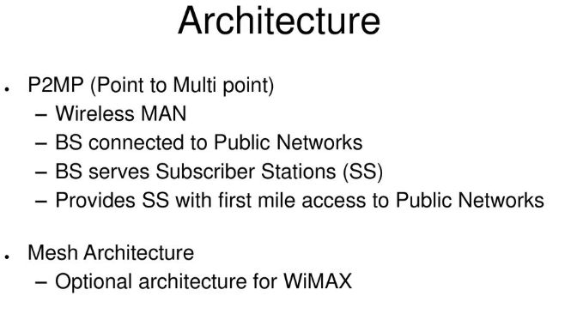

Slide 17
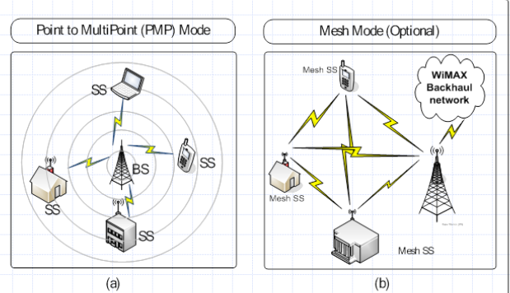

Slide 18
WMAN Network Architecture
Draw and explain the WMAN architecture.

Slide 19
WiMAX is a separate radio system that is designed to either supplement or replace the existing broadband Internet distribution systems
Figure shows a typical distributed WiMAX network architecture.
With a distributed WiMAX network architecture, the WiMAX system simply becomes an extension of the Internet or public switched telephone network (PSTN) to the mobile user
The cell equipment in the WiMAX BS comprises the basic BS equipment, radio equipment, and a BS link to the backbone network.

Slide 20
The BS provides the interface between the mobile users (residential Internet access, Wi-Fi hotspots, or notebooks with WiMAX adapter) and the WiMAX network.
The coverage radius of a typical BS in urban areas is around 500–900 m.
Network service providers will simply expand their networks based on system usage leveraging standard IP components.
A distributed WiMAX network architecture can be significantly lighter and easier to install compared with traditional cellular-based network

Slide 21
It can substantially reduce capital and operational expenses operators will be able to deploy at a greater speed at less cost.
Specific WiMAX distributed network architecture provides a simple, peer-to-peer network architecture that is a flat, all IP-based design in a manner similar to that of current 802.11 Wi-Fi networks
Network Components (What are the components of Wimax)
The main components of the WiMAX system are the BS, WiMAX receiver, and the backhaul
WiMAX base station: A WiMAX BS consists of indoor electronics and a
WiMAX tower.

Slide 22

A WiMAX BS can provide coverage to a very large area up to a radius of 6 miles.
Any wireless device within the coverage area would be able to access the Internet.
The WiMAX BSs would use the MAC layer defined in the standard.
A common interface makes the networks interoperable and would allocate uplink (UL) and downlink (DL) bandwidth to subscribers according to their needs, on an essentially real-time basis.

Slide 23
Each BS provides wireless coverage over an area called a cell.
Theoretically, the maximum, radius of a cell is 50 km or 30 miles; however, practical considerations limit it to about 10 km or 6 miles.
A BS and one or more subscriber stations (SSs) can form a cell with a P2MP structure.
On air, the BS controls activity within the cell, including access to the medium by SSs, allocations to achieve QoS, and admission to the network based on network security mechanisms.

Slide 24

2.WiMAX receiver: A WiMAX receiver may have a separate antenna or could be a standalone box or an interface card sitting on the laptop or computer or any other device.
This is also referred to as customer premise equipment (CPE)
An 802.16-based system often uses fixed antenna at the SS site.
The antenna is mounted on the roof..
A BS typically uses either sectored/directional or omnidirectional antennas.
A fixed SS typically uses directional antenna whereas a mobile or portable SS usually uses an omnidirectional antenna.

Slide 25
Backhaul: A WiMAX tower station can connect directly to the
Internet using a high-bandwidth wired connection.
It can also connect to another WiMAX tower using a LOS, microwave link.
Backhaul refers to the connection from the access point to the BS and from the BS to the core network.
It is possible to connect several BSs to one another using high-speed backhaul microwave links.
This allows for roaming by a WiMAX subscriber from one BS coverage area to another, similar to the roaming enabled by cell phones

Slide 26
Each WiMAX service provider uses one or more licensed operating frequencies somewhere between 2 and 11 GHz.
WiMAX link can transfer data (including handshaking and other overhead) at up to 70 Mbps, but most commercial WiMAX services are significantly slower than that.
as more and more users share a single WiMAX tower and BS, there is a signal quality deterioration

Slide 27
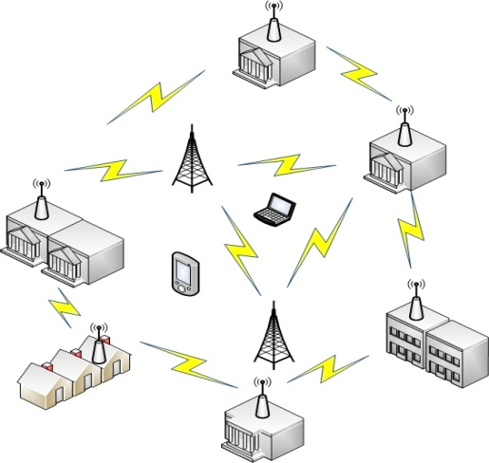
WiMAX mesh network architecture
Mesh networks --a dynamic topology that show a variable and constant change with growth or decline, and consist of nodes whose communication at the physical level occurs through variants of the IEEE 802.11 and IEEE 802.16 standard, and whose routing is dynamic.
In mesh networks, the access point / base stations area is usually fixed.

Slide 28
Mesh mode is a type of operation that can interconnect multiple mobile clients together with many WiMAX base stations (nodes).
It forms a network of connections so as to provide a wide coverage area for mobile clients.
All the clients can communicate with each other and there is no need for an intermediate node to act as the mediator of the network.
In this mode, the IEEE 802.16 can provide broadband access with wireless support both single-hop and multi-hop settings
The basic topology of an IEEE 802.16 mesh network consists of two participating entities, called Base Station (BS) and Subscriber Station (SS),

Slide 29
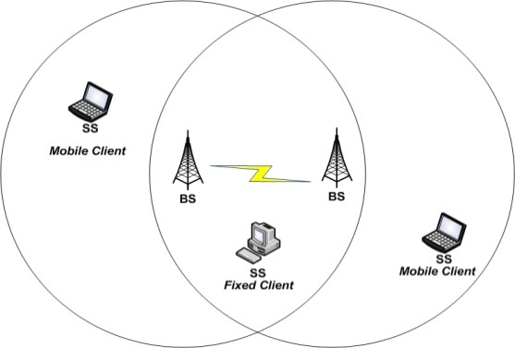
The BS is the central node, responsible for coordinating all the communication and providing connectivity to the client stations (fixed or mobile).
Operation
The most effective way to discover the operation of the mesh network is the routing protocol,
which scans the different possible routes / paths of data flow, on the basis of a pivot table where devices such as BS select the most efficient route to follow to reach a goal, while taking into account that the greater the speed, the packet loss, or the faster the access to the Internet (and others).
This scan is carried out several times per second and is transparent to the user, even when it occurs at re-routing access gateways, which are the nodes that have direct access to the internet

Slide 30
An important feature of mesh networks is the concept of roaming, also known as a transparent handoff mobility scheme offering fast handoff in wireless networks.
This makes it feasible for users to become mobile clients who can move around between network nodes without losing the connection at the time of exchange.
The practical consequence is that the system allows geographical mobility.
The system will always know which jumps are required for the request of a customer at any point in the network so that it can reach the Internet in the most efficient manner possible.

Slide 31
In a WiMAX mesh network, a “Mesh BS” (MBS – mesh base station) provides the external backhaul link.
The backhaul links connect the WiMAX network to other communication networks.
There may be multiple Mesh BSs in a network; other nodes are known as ‘‘Mesh SSs” (MSS – mesh subscriber stations).
In point-to-multipoint mode, the SSs are under the direct control of the BS.
In Mesh mode, the uplink and downlink is not clearly separated and SSs can communicate with each other without communicating with the BS.

Slide 32
State some functions of the Mesh architecture.
Mesh architecture catches the great security envisioned by the initial Internet pioneers. Mesh probably offers benefits to the service provider involving negating the demand for a separate backhaul network and reliability. The safety function of the mesh network is important in that if one node crashes, backhaul traffic could be routed around that failed node reducing the service division to only those subscribers undeviatingly served by that abandoned base station.

Slide 33
Features of WiMAX( List features of IEEE802.16)
Flexible architecture: WiMAX supports several system architectures, including P2P, P2MP, and ubiquitous coverage.
The WiMAX MAC supports P2MP and ubiquitous service by scheduling a time slot for each SS.
If there is only one SS in the network, the WiMAX BS will communicate with the SS on a P2P basis.
A BS in a P2P configuration may use a narrower beam antenna to cover longer distances

Slide 34
2.High security: WiMAX supports Advanced Encryption Standard (AES) and Triple Data Encryption Standard (3DES).
By encrypting the links between the BS and the SS, WiMAX provides subscribers with privacy (against eavesdropping) and security across the broadband wireless interface.
Security also provides operators with strong protection against theft of service.
WiMAX also provides protection for data that are being transmitted by different users on the same BS.

Slide 35
3.WiMAX QoS: WiMAX can be dynamically optimized for the mix of traffic that is being carried.
Five types of services are supported:
unsolicited grant service (UGS),
real-time polling service (rtPS),
extended real-time polling service (ertPS),
non-real-time polling service (nrtPS),
best effort (BE) service.
4. Quick deployment: Compared with the deployment of wired solutions, WiMAX requires little or no external plant construction.
Once the antenna and equipment are installed and powered, WiMAX is ready for service.

Slide 36
5. OFDM-based Physical Layer
The WiMAX physical layer (PHY) is based on orthogonal frequency division multiplexing, a scheme that offers good resistance to multipath, and allows WiMAX to operate in NLOS conditions.
6. Very High Peak Data Rates
WiMAX is capable of supporting very high peak data rates. In fact, the peak PHY data rate can be as high as 74Mbps when operating using a 20MHz wide spectrum.
More typically, using a 10MHz spectrum operating using TDD scheme with a 3:1 downlink-to-uplink ratio, the peak PHY data rate is about 25Mbps and 6.7Mbps for the downlink and the uplink, respectively.
. Support for Advanced Antenna Techniques
The WiMAX solution has a number of hooks built into the physical-layer design, which allows for the use of multiple-antenna techniques, such as beamforming, space-time coding, and spatial multiplexing.

Slide 37
7. Flexible and Dynamic per User Resource Allocation
Both uplink and downlink resource allocation are controlled by a scheduler in the base station. Capacity is shared among multiple users on a demand basis, using a burst TDM scheme.
8. Mobility: The IEEE 802.16e amendment has added key features in support of mobility.
The mobile WiMAX variant of the system has mechanisms to support secure seamless handovers for delay-tolerant full-mobility applications, such as VoIP.
These improvements, which include scalable OFDMA,MIMO, and support for idle/sleep mode and handoff, will allow full mobility at speeds up to 160 km/h.

Slide 38
9. Cost-effective: WiMAX is based on an open, international standard. Mass adoption of the standard, and the use of low-cost mass-produced chipsets, will bring costs down
10. Wider coverage: WiMAX dynamically supports multiple modulation levels, including binary phase-shift keying (BPSK), quadrature phase-shift keying (QPSK), 16 QAM, and 64 QAM.
When equipped with a high-power amplifier and operating with a low-level modulation (BPSK or QPSK, for example), WiMAX systems are able to cover a large geographic area when the path between the BS and the SS is unobstructed.

Slide 39
11. NLOS operation: WiMAX is based on OFDM technology, which has the inherent capability of handling NLOS environments.
This capability helps WiMAX products deliver broad bandwidth in an NLOS environment, which other wireless products cannot do.
12. High capacity: Using higher modulation (64 QAM) and channel bandwidth, WiMAX systems can provide significant bandwidth to end-users.

Slide 40
WiMAX Mobility Support
The IEEE 802.16e-2005 standard defines a framework for supporting mobility management. WiMAX envisions the following four mobility-related usage scenarios:
1. Nomadic: The user is allowed to take a fixed SS and reconnect from a different point of attachment.
2. Portable: Nomadic access is provided to a portable device, such as a PC card, with expectation of a best-effort handover.
3. Simple mobility: The subscriber may move at speeds up to 60 km/h with brief interruptions (less than 1 s) during handoff.
4. Full mobility: Up to 120 km/h mobility and seamless handoff (less than 50 ms latency and <1% packet loss) are supported

Slide 41
Network Protocols -WMAN

Slide 42
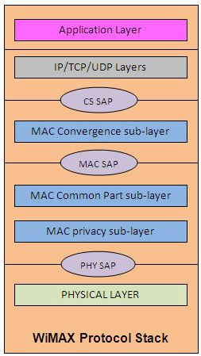
Network Protocols
The 802.16 protocol stack is shown in Fig..
The IEEE 802.16 standard is structured in the form of a protocol stack with well-defined interfaces.
The MAC layer is formed with three sublayers:
Service-specific convergence sublayer (CS),
MAC common part sublayer (CPS),
privacy sublayer.
The 802.16 protocol stack is shown in Fig.. Draw and explain Wimax protocol stack.

Slide 43
The MAC CS receives higher level data through CS service access point (SAP) and provides transformation and mapping into MAC service data unit (SDU).
MAC SDUs are then received by MAC CPS through MAC SAP.
The specification targeted two types of traffic transported through IEEE 802.16 networks:
Asynchronous transfer mode (ATM)
Packets.

Slide 45
MAC common part sublayer (CPS)
It is core part of the MAC layer, defining medium access method.
The CPS provides functions related to duplexing and channelization, channel access, packet data unit (PDU) framing, network entry, and initialization.
This provides the rules and mechanism for system access, bandwidth allocation, and connection maintenance.
QoS decisions for transmission scheduling are also performed within the MAC CPS.

Slide 46
Privacy Sublayer
The privacy layer lies between the MAC CPS and the PHY layer.
Security is a major issue for public networks.
This sublayer provides the mechanism for encryption and decryption of data transferring to and from PHY layer, and is also used for authentication and secure key exchange.
Data, PHY control, and statistics are transferred between the MAC CPS and the PHY layer through the PHY SAP.

Slide 47
Physical Layer
The PHY layer includes multiple specifications which make the standard adaptable to different frequency ranges
Different variants of the IEEE 802.16 PHY layer with their capabilities and conditions of operation.
The original version of the standard on which WiMAX is based (IEEE 802.16) specified a PHY layer operating in the 10–66 GHz range.
802.16a, updated to 802.16-2004 in 2004, added specifications for the 2–11 GHz range.
802.16-2004 was updated by 802.16e-2005 in 2005 and uses scalable orthogonal frequency division multiple access (SOFDMA) as opposed to the orthogonal frequency division multiplexing version with 256 subcarriers.

Slide 48
Scalable Orthogonal Frequency Division Multiple Access (SOFDMA) The concept of scalability was introduced as part of the OFDMA PHY layer mode of the IEEE 802.16 WMAN standard.
A scalable PHY layer allows standard-based solutions to deliver optimal performance in channel bandwidths ranging from 1.25 to 20 MHz, with fixed subcarrier spacing for both fixed and portable/mobile usage models while keeping product costs low.
A subchannel structure, with variable fast Fourier transform (FFT) sizes per channel bandwidth, enables scalability.

Slide 49
802.16e, has multiple antenna support through MIMO.
Its benefits –
Terms of coverage,
Self-installation,
Power consumption,
Frequency reuse
Bandwidth efficiency,
Full mobility support.
IEEE 802.16 standard has been standardized -European Telecommunications Standards Institute (ETSI),High-Performance Metropolitan Area Network (HIPERMAN).

Slide 50
Supported band of frequency. The IEEE 802.16 -licensed and unlicensed bands of frequency:
10–66 GHz licensed band:
In this frequency band, due to shorter wavelength, LOS operation is required and as a result the effect of multipath propagation is neglected.
It promises to provide data rates up to 120 Mbps in this frequency band.
2. 2–11 GHz licensed and licensed exempt:
It operates in near LOS and NLOS environment and to mitigate the effect of multipath propagation.

Slide 51
IEEE 802.16 physical layer interface variants. The standard has assigned a unique name to each physical interface
1.WMAN-SC: - operate in 10–66 GHz frequency band.
single-carrier modulation with adaptive burst profiling, in which transmission parameters, including the modulation and coding schemes, may be tuned individually to each SS on a frame-by-frame basis.
supports both FDD and TDD to separate UL and DL.
supports half-duplex FDD,
Access in UL direction is done by a combination of TDMA and demand assignment multiple access (DAMA);

Slide 52
UL channel is divided into several time slots.
Communication on the DL in ATM architecture is using TDM.
It also specifies the randomization, forward error correction (FEC), modulation, and coding schemes.
2.WMAN-SCa:
This is based on single-carrier modulation targeted for 2–11 GHz
Access is done by TDMA technique both in UL and DL; additionally, TDM is also supported in DL.

Slide 53
3. WMAN-OFDM:
It is based on OFDM with a 256-point transform to support multiple SSs in 2–11 GHz
Access is done by TDMA.
The WiMAX forum has adopted this PHY layer specification for broadband wireless access.
Due to employing OFDM and other features like multiple FEC method, this is the most suitable candidate to provide fixed support in NLOS environment.

Slide 54
4. WMAN-OFDMA:
It uses OFDMA with at least a single support of specified multipoint transform (2048, 1024, 512, or 128) to provide combined fixed and mobile broadband wireless access.
Operation is limited to below 11 GHz licensed band.
multiple access is provided by addressing a subset of the multiple carriers to individual receivers.
5. WHUMAN: This wireless high-speed unlicensed metropolitan access network (WHUMAN) is targeted for license-exempt band below 11 GHz.
Any of the air interfaces specified for 2–11 GHz can be used for this.
This supports only TDD for duplexing.

Slide 55
WiMAX is intended as a solution for metropolitan broadband access applications; however, multipath effects from buildings and other obstructions must be overcome.
So, the OFDM versions of WiMAX were developed.
In a single-carrier system, a single carrier is digitally modulated with a relatively fast symbol rate.
In an operating environment with severe multipath conditions, the use of a fast symbol rate can result in loss of data and poor signal performance.

Slide 56
An OFDM signal actually consists of many orthogonal carriers, and each signal is digitally modulated with a relatively slow symbol rate.
Because of the slower symbol rates, such signals are less affected by multipath interference, which creates delayed and reflected versions of transmitted signals.
By transmitting one symbol on multiple carriers, it is possible to use FEC to reconstruct the contents of faulty carriers.
commercial interest is in the 802.16d and 802.16e standards, as the lower frequencies used in these variants suffer less from inherent signal attenuation and therefore give improved range and in-building penetration

Slide 57
Compare the physical layer interfaces

Slide 58
WMAN-OFDM PHY layer is the version of the 256-point OFDM-based air interface specification. Of these 256 subcarriers, 192 are used for user data, 56 are nulled for guard band, and 8 are used as pilot subcarriers for various estimation purposes.
Benefits of this mechanism are:
Lower peak to average ratio,
Faster FFT calculation,
Less stringent requirements for frequency synchronization compared to 2048-point WMAN-OFDMA.

Slide 59
Some of the other mechanisms of the PHY layer are as follows:
1. Robust error control mechanism,
2. Adaptive modulation and coding,
3. Space time block codes (STBC),
4. Adaptive antenna

Slide 60
1.Robust error control mechanism: FEC is done in two phases through the outer Reed–Solomon (RS) code and the inner convolutional code (CC).
The RS coder corrects burst error at the byte level.
It is particularly useful for OFDM links in the presence of multipath propagation.
The CC corrects independent bit errors.
2. Adaptive modulation and coding: WiMAX supports a variety of modulation and coding schemes and allows for the scheme to change on a burst-by-burst basis per link, depending on channel conditions.

Slide 61
Using the channel quality feedback indicator, the mobile can provide the BS with feedback on the DL channel quality.
For the UL, the BS can estimate the channel quality, based on the received signal quality
The specified modulation scheme in the DL and UL are BPSK, QPSK, 16 QAM and 64 QAM to modulate bits to the complex constellation points.
The FEC options are paired with the modulation schemes to form burst profiles.
There are trade-offs between data rate and robustness, depending on the propagation conditions

Slide 63
3. Space–time block codes: Space–time codes additionally improve the performance and make spatial diversity usable.
The signal copy is not only transmitted from another antenna but also at another time.
This delayed transmission is called delayed diversity.
Space–time codes combine spatial and temporal signal copies and can be designed in two different ways:
(i) Space–time block code (STBC)
(ii) Space–time trellis code (STTC).

Slide 64
STBC transmits multiple redundant copies of the data from multiple antennas.
Receiver combines multiple copies of the received signals optimally to overcome multipath.
STBC can be implemented in the DL to provide transmit diversity.
The signals S1 and S2 are multiplexed in two data chains.
After that a signal replication is added to create the STBC.

Slide 65
4. Adaptive antenna system (AAS): Multiple antennas are used to transmit a subset of each OFDM subcarrier.
For example, if there are four antennas and 200 subcarriers (192 data subcarriers +8 pilot subcarriers) for transmission, then 200 subcarriers are divided into four groups of 50 subcarriers each.
Each of the four antennas transmits one group.
Receivers perform channel estimation on each beam and provide the feedback regarding the channel information to the transmitter

Slide 66
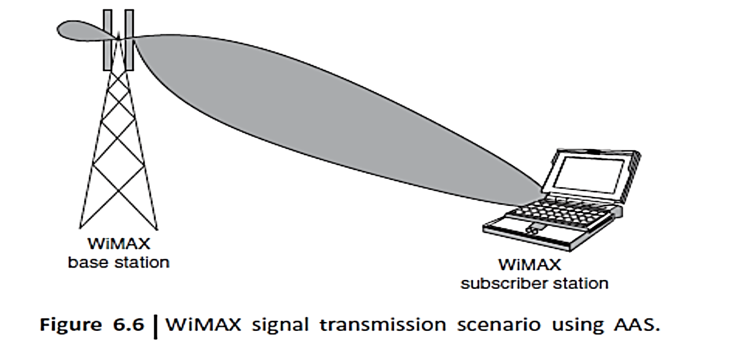
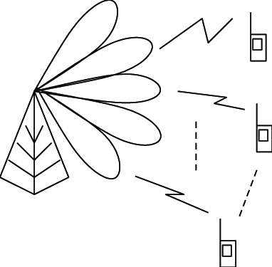
AAS can be used to serve multiple SSs with higher throughput.
A technique known as space division multiple access (SDMA) is employed here where multiple SSs that are separated (in space) can transmit and receive at the same time over the same subchannel.
Explain adaptive antenna Mechanism

Slide 67
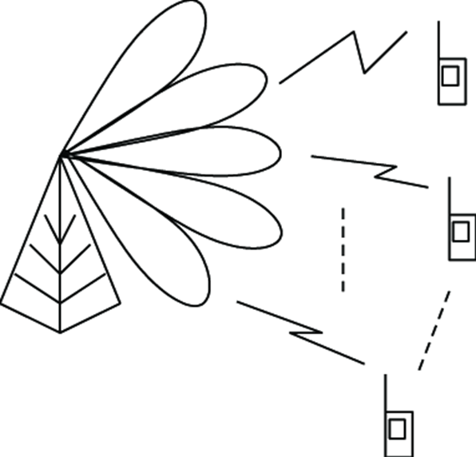
For WiMAX, the signal transmission scenario -AAS can focus its transmit energy to the direction of a receiver.
While receiving, it can focus to the direction of the transmitting device.
The technique used in AAS is known as beam forming or beam steering or beam shaping.
It works by adjusting the width and the angle of the antenna radiation pattern

Slide 68
Explain the physical layer features

Slide 69
Radio link control. The advanced technology of 802.16 PHY layer requires equally advanced radio link control (RLC), particularly the capability of the PHY layer to transit from one burst profile to another.
The RLC must control this capability as well as the traditional RLC functions of power control and ranging.
RLC begins with periodic BS broadcast of the burst profiles that have been chosen for the UL and DL.
During initial access, the SS performs initial power leveling and ranging using ranging request (RNG-REQ) messages transmitted in initial maintenance windows.

Slide 70
The adjustments to the SS’s transmit time advance, as well as power adjustments, are returned to the SS in ranging response (RNG-RSP) messages.
For ongoing ranging and power adjustments, the BS may transmit unsolicited RNG-RSP messages commanding the SS to adjust its power or timing
After initial determination of UL and DL burst profiles between the BS and a particular SS, RLC continues to monitor and control the burst profiles.
The RLC continues to adapt the SS’s current UL and DL burst profiles to the environment conditions ever striving to achieve a balance between robustness and efficiency

Slide 71
MAC Layer
The primary task of the WiMAX MAC layer is to provide an interface between the higher transport layers and the PHY layer.
the IEEE 802.16 MAC describes a number of CSs that describe how wireline technologies such as Ethernet, ATM, and IP are encapsulated on the air interface, how data are classified, etc.
Secure communications are delivered by using secure key exchange during authentication and encryption using Advanced Encryption Standard (AES) or Data Encryption Standard (DES) (as the encryption mechanism) during data transfer.

Slide 72
Features of the MAC layer: 1. Power-saving mechanisms (using sleep mode and idle mode), 2.Handover mechanisms
Sub channelization
A single user in an OFDM WiMAX system can use all subcarriers at any given time.
In OFDMA, subsets of subcarriers are assigned to multiple users, allowing a number of subscribers to be served simultaneously.
Using a technique known as sub channelization, specific carrier groups are used for each subscriber.
These subcarrier assignments change dynamically to overcome the effects of multipath interference

Slide 73
Sub channelization is a key concept for effective WiMAX network operation.
The technique makes it possible to group a number of OFDM carriers into blocks, and then assign each block to a different WiMAX BS sector.
The blocks, which contain a number of adjacent carriers, can be spread over the full operating frequency range.
By using adjacent BS sections, the effects of interference can be minimized.
A WiMAX network’s sub-channel index controls the use of different blocks over its operating frequency spectrum

Slide 74
WiMAX systems can be used in TDD, FDD, or half-duplex FDD configurations.
In a TDD approach, the BS and the SS each transmit on the same frequency, although separated in time.
The BS transmits a DL subframe, followed by a short gap called a transmit/receive transition gap (TTG), and then individual subscribers transmit the UL subframes.
Subscribers are accurately synchronized so that their transmissions do not overlap with each other when they arrive at the BS.
Following all UL subframes, another short gap called a receive/transmit transition gap (RTG) is allocated before the BS can start transmitting again.

Slide 75
In WiMAX, the whole-time axis is divided into frames .
A frame consists of an UL subframe and a DL subframe.
A frame is a structured sequence of data of fixed duration comprising a DL burst and an UL burst.
These bursts or subframes contain different data for different users.

Slide 76
The frame structure makes use of the following power levels for efficiency and robustness
1. Initial maintenance: First access by stations to detect round-trip-time to the BS as well as necessary transmission power (random choice of a time slot in that field by backoff mechanism); collisions are possible.
2. Request contention: Demands reservations in coming UL maps (again by backoff mechanism); collisions are possible.
The MAC includes service-specific CSs that interface to higher layers. The sublayer below the common part sublayer is the privacy sublayer.
Service-specific CS: IEEE Standard 802.16 defines two general service-specific CSs for mapping services to and from 802.16 MAC connections.

Slide 77
The ATM CS is defined for ATM services, and the packet CS is defined for mapping packet services such as IPv4, IPv6, Ethernet, and virtual local area network (VLAN).
The primary task of the sublayer is to classify SDUs to the proper MAC connection, preserve or enable QoS, and enable bandwidth allocation.
The mapping takes various forms depending on the type of service
2. Common part sublayer: The 802.16 MAC is designed to support a P2MP architecture with a central BS handling multiple independent sectors simultaneously.

Slide 78
On the DL, data to SSs are multiplexed in TDM. The UL is shared between SSs in TDMA fashion. The 802.16 MAC is connection-oriented.
All services, including inherently connectionless services, are mapped to a connection.
This provides a mechanism for requesting bandwidth associating QoS and traffic parameters, transporting and routing data to the appropriate CS, and all other actions associated with the contractual terms of the service.
Connections are referenced with 16-bit connection identifiers (CIDs) and may require continuously granted bandwidth or bandwidth on demand

Slide 79
Each SS has a standard 48-bit MAC address, but this serves mainly as an equipment identifier, because the primary addresses used during operation are the CIDs.
Upon entering the network, the SS is assigned three management connections in each direction
The first is used for the transfer of short, time-critical MAC and radio link control (RLC) messages.
The primary management connection is used to transfer longer, more delay tolerant messages such as those used for authentication and connection setup.

Slide 80
2. The secondary management connection is used for the transfer of standard-based management messages such as dynamic host configuration protocol (DHCP), trivial file transfer protocol (TFTP), and simple network management protocol (SNMP).
3. In addition to these management connections, SSs are allocated transport connections for the contracted services.
Transport connections are unidirectional to facilitate different UL and DL QoS and traffic parameters; they are typically assigned to services in pairs

Slide 81
MAC PDU Formats
The MAC PDU is the data unit exchanged between the MAC layers of the BS and its SSs.
MAC PDUs contain either MAC management messages or CS data. MAC PDU consists of a fixed-length generic MAC header, a variable-length payload, and an optional cyclic redundancy check (CRC) code.

Slide 82
Three types of MAC subheader may be present.
The grant management subheader is used by an SS to convey bandwidth management needs to its BS.
The fragmentation subheader contains information that indicates the presence and orientation in the payload of any fragments of SDUs.
The packing subheader is used to indicate the packing of multiple SDUs into a single PDU.

Slide 83
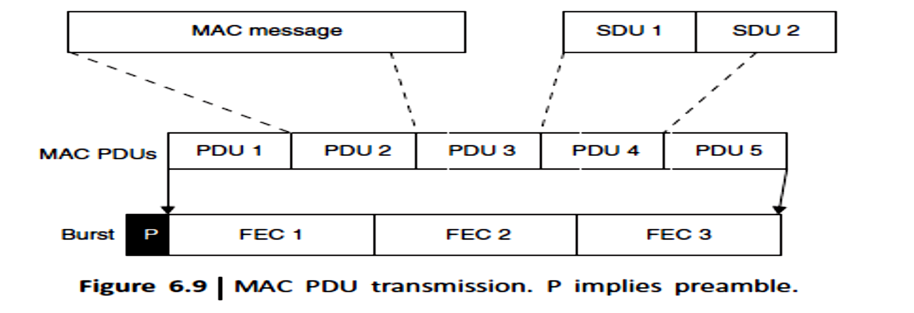
Transmission of MAC PDUs. The IEEE 802.16 MAC supports various higher layer protocols such as ATM or IP.
Incoming MAC messages or SDUs from corresponding CSs are formatted according to the MAC PDU format (here the SDUs 1 and 2 are formatted to PDU4)
FEC can be done to minimize the errors.

Slide 84
IEEE 802.16 takes advantage of incorporating the packing and fragmentation processes with the bandwidth allocation process to maximize the flexibility, efficiency, and effectiveness of both
Fragmentation is the process in which a MAC SDU is divided into one or more MAC SDU fragments.
Packing is the process in which multiple MAC SDUs are packed into a single MAC PDU payload.
Both processes may be initiated by either a BS for a DL connection or an SS for a UL connection.
Draw and explain Mac Pdu

Slide 85
Bandwidth allocation in IEEE 802.16 can be made in two ways:
By grant per connection (GPC) or By grant per service station (GPSS).
In the first case, each grant is associated with a specific connection.
The disadvantage of this approach is that it creates additional overhead.
In the other approach, GPSS, the SS is given a single grant for all its connections.
Then the local scheduler in the SS decides how to allocate the transmission opportunities to each connection.

Slide 86
MAC Quality of Service (QoS)
A key feature of 802.16 is that it is a connection-oriented technology.
The SS cannot transmit data until it has been allocated a channel by the BS.
This allows 802.16e to provide strong support for QoS.
In WiMAX, QoS is supported by allocating each connection between the SS and the BS to a specific QoS class.

Slide 87
The IEEE 802.16 MAC layer defines five service classes:
UGS, rtPS, ertPS, nrtPS, and BE service.
The scheduling algorithms needed for implementing the first three types of services are implemented in the BS (while allocating UL bandwidth to each SS). Each SS negotiates its service policies with the BS at the connection setup time.
These five service classes are explained as follows:
Unsolicited Grant service (UGS): It offers fixed size grants on a real-time periodic basis, which eliminates the overhead and latency of SS request and assures that grants are available to meet the flow’s real-time needs.

Slide 88
Typical UGS applications are delay-sensitive speech signal communications, VoIP (without silence suppression), etc.
2. Real Time Polling Service (rtPS): It is designed to support real-time service flows that generate variable size data packets on a periodic basis for streaming video.
This service requires more request overhead than UGS but supports variable grant sizes for optimum data transport efficiency.
3. Extended Real Time Polling Service (ertPS): It was added in 802.16e-2005 (or mobile-WiMAX) and supports real-time applications where the applications require guaranteed data rate and delay

Slide 89
The ertPS is designed to support real-time service flows that generate variable-sized data packets on a periodic basis such as VoIP (with silence suppression).
4. Non Real Time Polling Service (nrtPS): It is designed to support non-real-time service flows that require variable size bursts in the UL on a regular (but not strictly periodic) basis.
5. Best Effort (BE) service: It is intended to be used for BE traffic where no throughput or delay guarantees are provided

Slide 90
Scheduling
A high-level QoS and scheduling support is one of the interesting features of the WiMAX standard.
These service-provider features are especially valuable because of their ability to maximize air link utilization and system throughput, as well as ensuring that SLAs are met as shown in Fig. 6.10.
The infrastructure to support various classes of services comes from the MAC implementation.
QoS is enabled by the bandwidth request and grant mechanism between various SSs and BSs.

Slide 91
The packet scheduler provides scheduling for different classes of services for a single user.
This would mean meeting (SLAs) requirements at the user level. Service level agreement
Users can be classified into various priority levels, such as standard and premium.

Slide 92
To enforce QoS requirements, all transmission need to be scheduled. The 802.16 MAC sublayer uses a scheduling algorithm for which the SS only needs to compete for initial entry into the network.
The scheduling algorithm also allows the BS to control QoS parameters by balancing the time slot assignments among the application needs of the SSs.
Basically there are two types of scheduling: centralized scheduling and decentralized scheduling.
In centralized scheduling, the BS assigns capacity to the other stations.
In decentralized scheduling, stations exchange scheduling information with their neighbors.
What is need of Scheduling in MAC layer in Wimax?

Slide 93
Each station notes the scheduling request of the neighbors.
The BS is no longer involved in scheduling, and it only assigns bandwidth

Slide 94
WMAN Applications
Two broad categories: private and public networks applications.
Private networks, used exclusively by a single organization, institution, or business, offer dedicated communication links for the secure and reliable transfer of voice, data, and video.
Quick and easy deployment is generally a high priority, and configurations are typically P2P or P2MP.
In public network, resources are accessed and shared by different users, including both businesses and private individuals.
Public networks generally require a cost-effective means of providing ubiquitous coverage, as the location of the users is neither predictable nor fixed.

Slide 95
The main applications of public networks are voice and data communication, although video communication is becoming increasingly popular
WMAN Applications:
Wireless Service Provider Backhaul
Banking Networks
Education Networks
Public Safety

Slide 96



Slide 100
Wireless Local Area Networks
Reference :Wireless Communication by Vijay Garg

Slide 101
WLAN Introduction
WLANs are flexible data communication systems that can be used for applications in which mobility is required.
In the indoor business environment, although mobility is not an absolute requirement, WLANs provide more flexibility than that achieved by the wired LAN.
Currently, WLANs can provide data rates up to 11 Mbps, but the industry is making a move toward high-speed WLANs.
Manufacturers are developing WLANs to provide data rates up to 54 Mbps or higher.
High speed makes WLANs a promising technology for the future data communications market.

Slide 102
WLANs are flexible data communications systems implemented as an extension or as an alternative for wired LANs.
Using radio frequency (RF) technology, WLANs transmit and receive data over the air, minimizing the need for wired connections. Thus, WLANs combine data connectivity with user mobility

Slide 103
The IEEE 802.11 committee is responsible for WLAN standards. WLANs include IEEE 802.11a (WiFi 5), IEEE 802.11b (WiFi), IEEE 802.11g and IEEE 802.11n

Slide 104
Recently, manufacturers have deployed WLANs for process and control applications. Retail applications have expanded to include wireless point of sale (WPOS).
The health-care and education industry are also fast-growing markets for WLANs.
WLANs provide high-speed, reliable data communications in a building or campus environment as well as coverage in rural areas. WLANs are simple to install.

Slide 105
In WLANs, the connection between the client and the user is accomplished by the use of a wireless medium such as RF or Infrared (IR) communications instead of a cable.
The wireless connection is usually accomplished by the user having a hand-held terminal or laptop that has an RF interface card installed inside the terminal or through the PC card slot of the laptop.
The client connection from the wired LAN to the user is made through an access point (AP) that can support multiple users simultaneously.
The AP can reside at any node on the wired network and acts as a gateway for wireless users’ data to be routed onto the wired network.

Slide 106
An important feature of WLANs is that they can be used independently of wired networks. They can be used as stand-alone networks anywhere to link multiple computers together without having to build or extend wired networks.
The network communications take place in a part of the radio spectrum that is designed as license free. In this band, 2.4–2.5 GHz, users can operate without a license so as long as they use equipment that has been of the type approved for use in the license-free band.
Standard WLANs are capable of operating at speeds in the range of 1–2 Mbps depending on the actual system.
The fastest WLANs use 802.11b high-rate standard to move data through air at a maximum speed of 11 Mbps.

Slide 107
The range of a WLAN depends on the actual usage and environment of the system.
It may vary from 100 feet inside a solid walled building to several thousand feet in an outdoor environment with direct line-of-sight.
Much like cellular phone systems WLANs are capable of roaming from the AP and reconnecting to the network through other APs residing at other points in the network.
This can allow the wired LAN to be extended to cover a much larger area than the existing coverage by the use of multiple APs

Slide 108
The following are a few advantages of deploying WLANs:
Mobility improves productivity with real-time access to information, regardless of worker location, for faster and more efficient decision making.
Cost-effective network setup for hard-to-wire locations such as older buildings and solid wall structures.
Reduced cost of ownership, particularly in a dynamic environment requiring frequent modification due to minimal wiring and installation costs per device and per user

Slide 109
There are several issues that should be considered in deploying the WLAN including:
Frequency allocation: Operation of a wireless network requires that all users operate in a common frequency band. The frequency band must be approved in each country.
Interference and reliability: In a wired LAN, one hears only the terminals connected to the network. In a WLAN, interference is caused by simultaneous transmission of information in the shared frequency band and by multipath fading. The reliability of a communication channel is measured by bit error rate (BER). Automatic repeat request (ARQ) and forward error correction (FEC) techniques are used to increase reliability.

Slide 110
Security: Radio waves are not confined to the boundary of buildings or campuses. There exists the possibility of eavesdropping and intentional interference. Data privacy over a radio medium is usually accomplished by using encryption.
Power consumption: WLANs are typically related to mobile applications. In these applications, battery power is a scarce resource. Therefore, the devices must be designed to be energy efficient.
Mobility: One of the advantages of a WLAN is the freedom of mobility. The devices should accommodate handoff at transmission boundaries to route data calls to mobile users.
Throughput: To support multiple transmissions simultaneously, spread spectrum techniques are often used.

Slide 111
WLAN Equipment
There are three main links that form the basis of the wireless network. These are:
LAN adapter: Wireless adapters are made in the same basic form as their wired counterparts: Personal Computer Memory Card International Association (PCMCIA) ,Card bus, PCI, and USB. They also serve the same function, enabling end-users to access the network. In a WLAN, they provide the interface between the network operating system and an antenna to create a transparent connection to the network.
Access point (AP): The AP is the wireless equivalent of an LAN hub. It receives, buffers, and transmits data between the WLAN and the wired network, supporting a group of wireless user devices.
What are WLAN equipment? Explain in detail

Slide 112
An AP is typically connected with the backbone network through a standard Ethernet cable, and communicates with wireless devices by means of an antenna. The AP or antenna connected to it is generally mounted on a high wall or on the ceiling.
APs have a range from 20 to 500 meters. A single AP can support between 15 to 250 users, depending on technology, configuration, and use. It is relatively easy to scale a WLAN by adding more APs to reduce network congestion and enlarge the coverage area.
Large networks requiring multiple APs deploy them to create overlapping cells for constant connectivity to the network. A wireless AP can monitor movement of a client across its domain and permit or deny specific traffic or clients from communicating through it.

Slide 113
Outdoor LAN bridges:
Outdoor LAN bridges are used to connect LANs in different buildings. When the cost of buying a fiber optic cable between buildings is considered, particularly if there are barriers such as highways or bodies of water in the way, a WLAN can be an economical alternative.
An outdoor bridge can provide a less expensive alternative to recurring leased line charges.
WLAN bridge products support fairly high data rates and ranges of several miles with the use of line-of-sight directional antennas. Some APs can also be used as a bridge between buildings of relatively close proximity.

Slide 114
WLAN Topologies
WLANs can be built with either of the following topologies:
Peer-to-peer (ad hoc) topology
Access point-based topology
Point-to-multipoint bridge topology
In peer-to-peer topology, client devices within a cell communicate directly to each other.

Slide 115
AP-based technology uses access points to bridge traffic onto a wired (Ethernet or Token Ring) or a wireless backbone.
AP enables a wireless client device to communicate with any other wired or wireless device on the network.
AP-based topology is more commonly used and demonstrates that the WLAN does not replace the wired LAN, it extends connectivity to mobile devices.

Slide 116
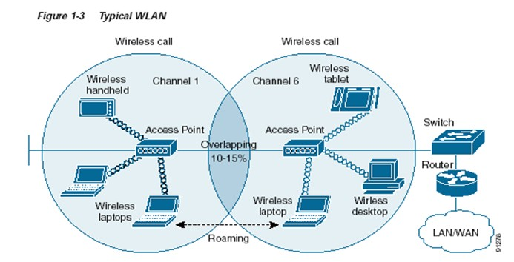

Slide 117
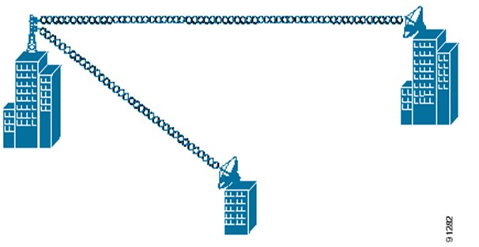
Point-to-multipoint bridge:
Wireless bridges connect LANs in one building to LANs in another building even if the buildings are miles apart.
These conditions receive a clear line-of-sight between buildings.
The line-of-sight range varies based on the type of wireless bridge and antenna used as well as environmental conditions.
Explain WLAN topologies

Slide 118
WLAN Technologies
The technologies available for use in a WLAN include
Infrared,
UHF (narrowband)
Spread spectrum implementation
Infrared Technology
Infrared is an invisible band of radiation that exists at the lower end of the visible electromagnetic spectrum.
This type of transmission is most effective when a clear line-of-sight exists between the transmitter and the receiver.

Slide 119
Two types of infrared WLAN solutions are available:
1.Diffused-beam,
2. Direct-beam (or line-of-sight).
Currently, direct-beam WLANs offer a faster data rate than the diffused-beam networks.
Direct-beam is more directional since diffused-beam technology uses reflected rays to transmit/receive a data signal.
It achieves lower data rates in the 1–2 Mbps range.
Infrared is a short-range technology.

Slide 120
When used indoors, it can be limited by solid objects such as doors, walls, merchandise, or racking. In addition, the lighting environment can affect signal quality.
For example, loss of communication may occur because of the large amount of sunlight or background light in an environment. Fluorescent lights also may contain large amounts of infrared.
This problem may be solved by using high signal power and an optimal bandwidth filter, which reduces the infrared signals coming from an outside source.

Slide 121
In an outdoor environment, snow, ice, and fog may affect the operation of an infrared based system.

Slide 122
UHF Narrowband Technology
UHF wireless data communication systems have been available since the early 1980s.
These systems normally transmit in the 430 to 470 MHz frequency range, with rare systems using segments of the 800 MHz range.
The lower portion of this band 430–450 MHz is referred to as the unprotected (unlicensed), and 450–470 MHz is referred to as the protected (licensed) band.
In the unprotected band, RF licenses are not granted for specific frequencies and anyone is allowed to use any frequencies, giving customers some assurance that they will have complete use of that frequency.

Slide 123
The term narrowband is used to describe this technology because the RF signal is sent in a very narrow bandwidth, typically 12.5 kHz or 25 kHz.
Power levels range from 1 to 2 watts for narrowband RF data systems. This narrow bandwidth combined with high power results in larger transmission distances than are available from 900 MHz or 2.4 GHz spread spectrum systems, which have lower power levels and wider bandwidths.

Slide 124
Spread Spectrum Technology
Most WLANs use spread spectrum technology, a wideband radio frequency
technique that uses the entire allotted spectrum in a shared fashion as
opposed to dividing it into discrete private pieces (as with narrowband).
The spread spectrum system spreads the transmission power over the entire usable spectrum.
This is obviously a less efficient use of the bandwidth than the narrowband approach.
However, spread spectrum is designed to trade off bandwidth efficiency for reliability, integrity, and security.

Slide 125
The bandwidth trade-off produces a signal that is easier to detect, provided that the receiver knows the parameters of the spread spectrum signal being broadcast.
If the receiver is not tuned to the right frequency, a spread spectrum signal looks like background noise.
By operating across a broad range of radio frequencies, a spread spectrum device could communicate clearly despite interference from other devices using the same spectrum in the same physical location.
In addition to its relative immunity to interference, spread spectrum makes eavesdropping and jamming inherently difficult.

Slide 126
: direct In commercial applications, spread spectrum techniques currently offer data rates up to 2 Mbps.
Two modulation schemes are commonly used to encode spread spectrum signals sequence spread spectrum (DSSS) and frequency hopping spread spectrum (FHSS).
FHSS uses a narrowband carrier that changes frequency in a pattern known to both transmitter and receiver. Properly synchronized, the net effect is to maintain a single logical channel.
To an unintended receiver, FHSS appears to be a short-duration impulse noise.

Slide 127
DSSS generates a redundant bit pattern for each bit to be transmitted. This bit pattern is called a spreading code.
The longer the code, the greater the probability that the original data can be recovered (and, of course the more bandwidth will be required).
To an unintended receiver DSSS appears as low-power, wideband noise and is rejected by most narrowband receivers.

Slide 128
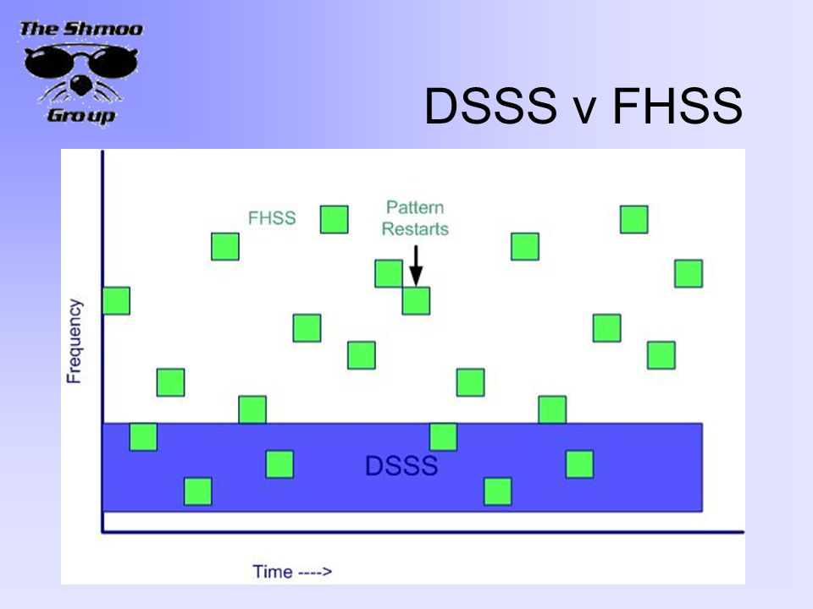
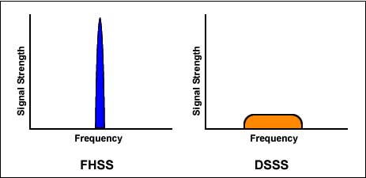

Slide 129
IEEE 802.11 WLAN
In 1997 the IEEE developed an international standard for WLANs: IEEE 802.11-1997. This standard was revised in 1999. Like other IEEE 802 standards, the 802.11 standard focuses on the bottom two layers of the OSI model, the physical layer (PHY) and data link layer (DLL).
The objective of the IEEE 802.11 standard was to define:
Medium access control (MAC) sublayer,
MAC management protocols and services, and
Three PHYs for wireless connectivity of fixed, portable, and moving devices within a local area.

Slide 130
The three physical layers are
IR baseband PHY,
FHSS radio in the 2.4 GHz band,
DSSS radio in the 2.4 GHz.
All three physical layers support both 1 and 2 Mbps operations.
WLANs support asynchronous data transfers that refer to the traffic that is relatively insensitive to time delays such as electronic mail and file transfers.
Optionally WLANs can also support the traffic, which is bounded by the specified time delay, to achieve an acceptable quality of service (QoS), such as packetized voice and video.

Slide 131
IEEE 802.11 Architecture
The architecture of the IEEE 802.11 WLAN is designed to support a network where most decision making is distributed to mobile stations.
This type of architecture has several advantages:
It is tolerant of faults in all of the WLAN equipment and eliminates possible bottlenecks a centralized architecture would introduce.
The architecture is flexible and can easily support both small, transient networks and large, semi permanent or permanent networks.
In addition, the architecture and protocols offer significant power saving and prolong the battery life of mobile equipment without losing network connectivity.

Slide 132
Two network architectures are defined in the IEEE 802.11 standard:
Infrastructure network: An infrastructure network is the network architecture for providing communication between wireless clients and wired network resources. The transition of data from the wireless to wired medium occurs via an AP. An AP and its associated wireless clients define the coverage area. Together all the devices form a basic service set.
Point-to-point (ad hoc) network: An ad hoc network is the architecture that is used to support mutual communication between wireless clients. Typically, an ad hoc network is created spontaneously and does not support access to wired networks. An ad hoc network does not require an AP.

Slide 133
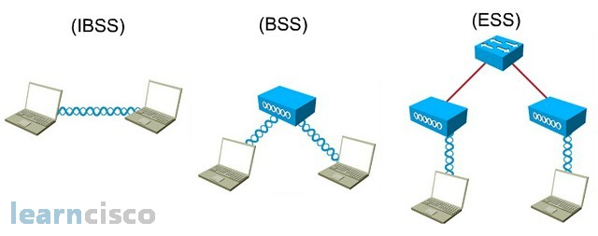
IEEE 802.11 supports three basic topologies for WLANs:
Independent basic service set (IBSS),
Basic service set,
Extended service set (ESS).
Define BSS and ESS and explain their role in the architecture

Slide 134
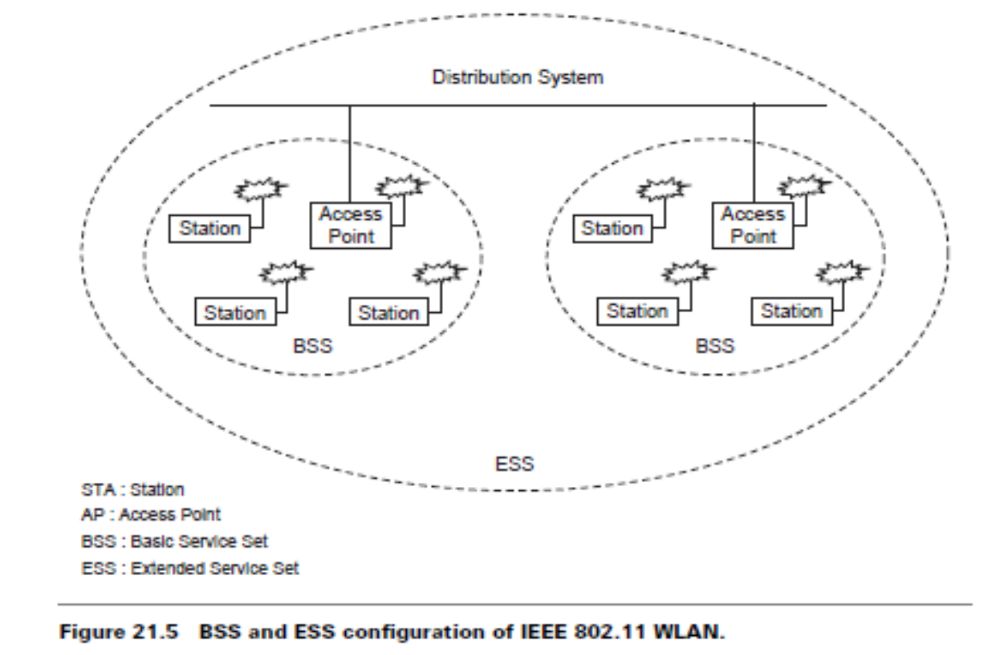
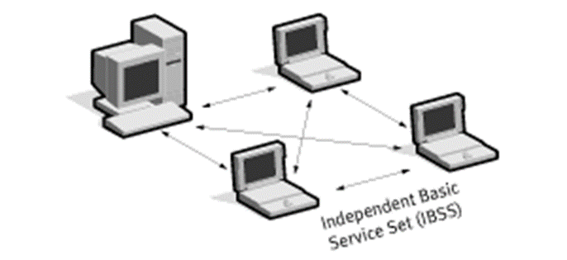

Slide 135
The MAC layer supports implementations of IBSS, basic service set, and ESS configurations.
IBSS configuration:
It is referred to as an independent configuration or ad hoc network.
An IBSS configuration is analogous to a peer-to-peer office network in which no single node is required to act as a server.
IBSS WLANs include a number of nodes or wireless stations that communicate directly with one another on an ad hoc, peer-to-peer basis. Generally, IBSS implementations cover a limited area and are not connected to any large network.
An IBSS is typically a short-lived network, with a small number of stations, that is created for a particular purpose.

Slide 136
Basic service set configuration
It relies on an AP that acts as the logical server for a single WLAN cell or channel.
Communications between station 1 and station 4 actually flow from station 1 to AP1 and then from AP1 to AP2 and then from AP2 to AP4 and finally AP4 to station 4 (refer to Figure 21.4).
An AP performs a bridging function and connects multiple WLAN cells or channels and connects WLAN cells to a wired enterprise LAN.

Slide 137
ESS configuration
It consists of multiple basic service set cells that can be linked by either wired or wireless backbones called a distributed system.
IEEE 802.11 supports ESS configurations in which multiple cells use the same channel, and configurations in which multiple cells use different channels to boost aggregate throughput.
To network the equipment outside of the ESS, the ESS and all of its mobile stations appear to be a single MAC layer network where all stations are physically stationary.
Thus, the ESS hides the mobility of the mobile stations from everything outside the ESS.

Slide 138
802.11 Physical Layer (PHY)
At the physical layer, IEEE 802.11 defines three physical characteristics for WLANs: Diffused infrared (baseband), DSSS, and FHSS.
All three support a 1 to 2 Mbps data rate. Both DSSS and FHSS use the 2.4 GHz ISM band (2.4–2.4835 GHz).

Slide 139
The physical layer provides three levels of functionality:
Frame exchange between the MAC and PHY under the control of the physical layer convergence procedure (PLCP) sublayer;
Use of signal carrier and spread spectrum (SS) modulation to transmit data frames over the media under the control of the physical medium dependent (PMD) sublayer; and
(3) Providing a carrier sense indication back to the MAC to verify activity on the media
Each of the physical layers is unique in terms of the modulation type, designed to coexist with each other and operate with the MAC.

Slide 140
DSSS PHY
In the DSSS PHY, data transmission over the media is controlled by the physical medium dependent (PMD) sublayer as directed by the physical layer convergence procedure ( PLCP) sublayer. The PMD sublayer takes the binary information bits from the PLCP protocol data unit (PPDU) and converts them into RF signals by using modulation and DSSS techniques.

Slide 141
Figure shows the PPDU frame, which consists of a PLCP preamble, PLCP header, and MAC protocol data unit (MPDU).
The PLCP preamble and PLCP header are always transmitted at 1 Mbps, and the MPDU can be sent at 1 or 2 Mbps.
The start of frame delimiter (SFD) contains information that marks the start of the PPDU frame. The signal field indicates which modulation scheme should be used to receive the incoming MPDU. The binary value in this field is equal to the data rate multiplied by 100 kbps.

Slide 142
Two modulation schemes,
Differential binary phase shift keying (DBPSK) — for 1 Mbps
Differential quadrature phase shift keying (DQPSK) — for 2 Mbps
The service field is reserved for future use.
The length field indicates the number of microseconds necessary to transmit the MPDU. The MAC layer uses this field to determine the end of a PPDU frame.
The CRC field contains the results of a calculated frame check sequence from the sending station.

Slide 143
The ITU CRC-16 error detection algorithm is used to protect the signal, service, and length field.
The SYNC field is 128 bits (symbols) in length and contains a string of 1s which are scrambled prior to transmission. The receiver uses this field to acquire the incoming signal and to synchronize the receiver’s carrier tracking and timing prior to receiving the SFD. The SFD field contains information to mark the start of the PPDU frame.
The SFD specified is common for all IEEE 802.11 DSSS radios.

Slide 144
All information bits transmitted by the DSSS PMD are scrambled using a self-synchronizing 7-bit polynomial. An 11-bit Barker code (1, 1, 1, 1, 1, 1, 1, 1, 1, 1, 1) is used for spreading.
In the transmitter, the 11-bit Barker code is applied to a modulo-2 adder together with each of the information bits in the PPDU.
The output of the modulo-2 adder results in a signal with a data rate that is 10 times higher than the information rate.
The result in the frequency domain is a signal that is spread over a wide bandwidth at a reduced RF power level.
At the receiver, the DSSS signal is convolved with the same 11-bit Barker code and correlated.

Slide 145
Each DSSS PHY channel occupies 22 MHz of bandwidth and allows for three noninterfering channels spaced 25 MHz apart in the 2.4 GHz frequency band (see Figure 21.9).
The maximum allowable radiated power for DSSS PHY varies from region to region (refer to Table 21.6). The transmit power is directly related to the range that a particular implementation can achieve.

Slide 147
FHSS PHY
In FHSS PHY, data transmission over media is controlled by the FHSS physical medium dependent (PMD) sublayer as directed by the FHSS PLCP sublayer.
The FHSS PMD takes the binary information bits from the whitened PSDU and converts them into RF signals by using carrier modulation and FHSS techniques (see Figure 21.10).

Slide 148
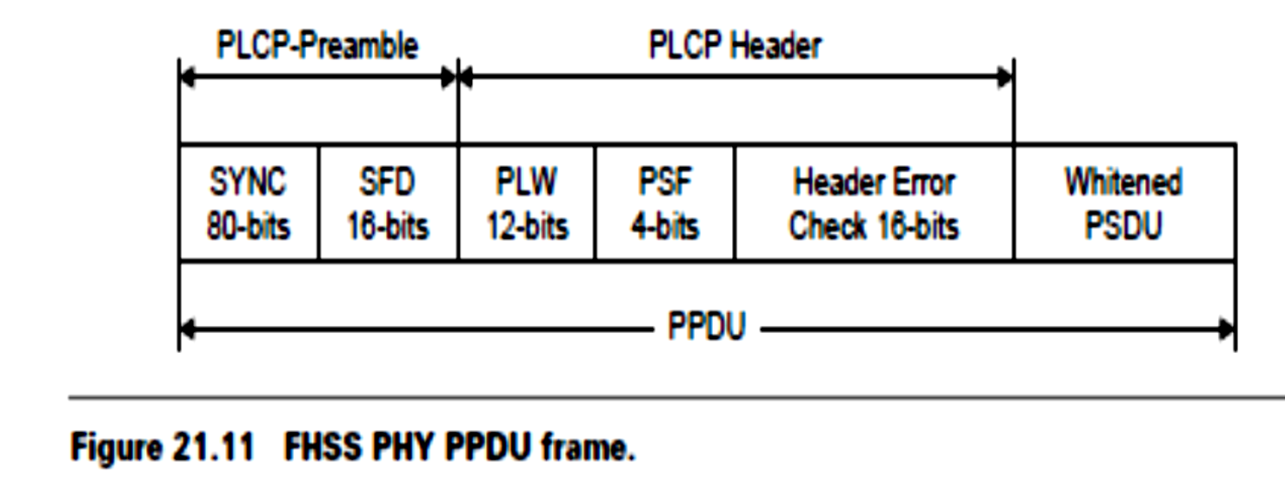
PPDU consists of: PLCP preamble, PLCP header, PLCP service data unit (PSDU).
The PLCP preamble is used to acquire the incoming signal and synchronize the receiver’s demodulator.
The PLCP header contains information about PSDU from the sending physical layer. The PLCP preamble and header are transmitted at 1 Mbps.
The sync field contains a string of alternating 0s and 1s pattern and is used by the receiver to synchronize the receiver’s packet timing and correct for frequency offsets.

Slide 149
The SFD field contains information marking the start of a PSDU frame. FHSS radios use a 0 0 0 0 1 1 0 0 1 0 1 1 1 1 0 1 bit pattern. The leftmost bit is transmitted first.
The PLCP length word (PLW) field specifies the length of the PSDU in octets and is used by the MAC layer to detect the end of a PPDU frame.
The PLCP signaling field (PSF) identifies the data rate of the whitened PSDU ranging from 1 to 4.5 Mbps in increments of 0.5 Mbps.

Slide 150
The header error check field contains the results of a calculated frame check sequence from the sending station.
The ITU CRC-16 error detection algorithm is used to protect the PSF and PLW fields.
Data whitening is used for the PSDU before transmission to minimize DC bias on the data if long strings of 1s or 0s are contained in the PSDU.
Data whitening is a process of reducing the data to white noise vector. More precisely, it decorrelates the individual components of a random vector and makes the variance 1.

Slide 151
The PHY stuffs a special symbol every 4 octets of the PDSU in a PPDU frame. A 127-bit sequence generator using the polynomial x^7+x^4+1 and a 32/33 bias-suppression encoding algorithm are used to randomize and whiten the data.
The FHSS PMD uses two-level Gaussian frequency shift key (GMSK) modulation to transmit the PSDU at the basic rate of 1 Mbps.
Four-level GFSK is an optimal modulation scheme defined in the standard that enables the whitened PSDU to be transmitted at a higher rate.

Slide 152
The value in the PSF field of the PLCP header is used to determine the data rate of the PSDU.
In GFSK modulation, the frequency is shifted on either side of the carrier hop frequency depending on whether the binary symbol from the PSDU is either a 1 or 0.
Channel hopping is controlled by FHSS PMD. The FHSS PMD transmits the whitened PSDU by hopping from channel to channel in a pseudo-random fashion using one of the hopping sequences.
Explain the frame structure of IEEE 802.11DSSS / IEEE 802.11FHSS.

Slide 153
802.11a Orthogonal Frequency Division Multiplexing (OFDM)
The OFDM PHY provides the capability to transmit PSDU frames at multiple data rates up to 54 Mbps for a WLAN where the transmission of multimedia content is a consideration.
The OFDM PHY defined for IEEE 802.11a is similar to the OFDM PHY specification of ETSI-HIPERLAN 2.
The PPDU is unique to the OFDM PHY. The PPDU frame consists of a PLCP preamble and signal and data fields (see Figure 21.12).
Explain the operating principle of OFDM used for IEEE 802.11a.

Slide 154
The receiver uses the PLCP preamble to acquire the incoming OFDM signal and synchronize the demodulator.
The PLCP header contains information about the PSDU from the sending OFDM PHY.
The PLCP preamble and the signal fields are always transmitted at 6 Mbps, BPSK-OFDM modulated using a convolutional encoding rate R =1/2.

Slide 155
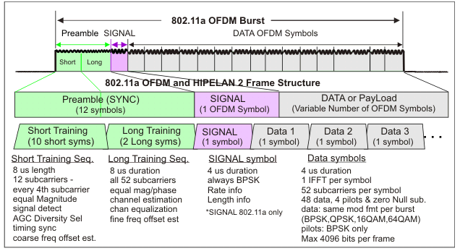

Slide 156
PLCP preamble field is used to acquire the incoming signal , train and synchronize the receiver.
The PLCP preamble consists of 12 symbols, 10 of which are short symbols, and 2 long symbols.
The short symbols are used to train the receiver’s automatic gain control (AGC) and obtain a coarse estimate of the carrier frequency and the channel.
The long symbols are used to fine-tune the frequency and channel estimates. Twelve subcarriers are used for the short symbols and 53 for the long. The training of an OFDM is accomplished in 16 s.
The signal is a 24-bit field that contains information about the rate and length of the PSDU. The signal field is convolutional encoded rate R = 1/2, BPSK-OFDM modulated.

Slide 157
Four bits are used to encode the rate, twelve bits are used to define the length, one reserved bit, a parity bit, and six 0 tail bits (see Table 21.7).

Slide 158
Length field: an unsigned 12-bit integer to indicate the number of octets in the PSDU.
Data Field
contains service field, PSDU, tail bits, and pad bits.
Six tail bits containing 0s are appended to the PPDU to ensure that the convolutional encoder is brought back to the zero state.
All the bits transmitted by the OFDM PMD in the data portion are scrambled using a frame-synchronous 127-bit sequence generator.
Scrambling is used to randomize the service, PSDU, pad bit, and data patterns, which may contain long strings of binary 1s or 0s.

Slide 159
The tail bits are not scrambled.
All information contained in the service PSDU, tail, and pad are encoded using convolutional encoding R = 1/2, 2/3, or 3/4 corresponding to the desired data rate.
Puncture codes are used for the higher data rates.
In OFDM modulation, the basic principle of operation is to divide a high-speed binary signal to be transmitted into a number of lower data rate subcarriers.

Slide 160
There are 48 data subcarriers and 4 carrier pilot subcarriers for a total of 52 nonzero subcarriers defined in IEEE 802.11a.
Each lower data rate bit stream is used to modulate a separate subcarrier from one of the channels in the 5 GHz band.
Intersymbol interference is generally not a concern for a lower speed carrier; however, the subchannels may be subjected to frequency selective fading.
Therefore, bit interleaving and convolutional encoding is used to improve the BER performance.

Slide 161
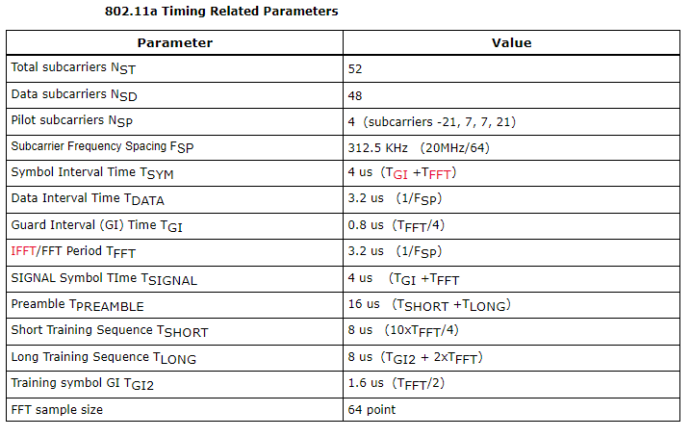

Slide 162
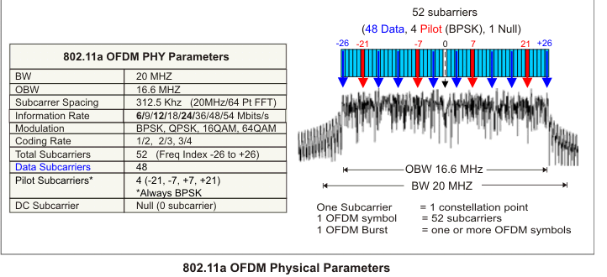

Slide 164
The 5 GHz frequency band is segmented into three 100 MHz bands for operation in the United States.

Slide 165
The upper band defines RF transmit power levels suitable for bridging applications while the lower band specifies a transmit power suitable for short-range indoor home and small office environments.

Slide 166
IEEE 802.11 Data Link Layer
The data link layer within 802.11 consists of two sublayers:
Logical link control (LLC) and
Media access control (MAC).
802.11 uses the same 802.2 LLC and 48-bit addressing as the other 802 LAN, allowing for simple bridging from wireless to IEEE wired networks, but the MAC is unique to WLAN.
The sublayer above MAC is the LLC, where the framing takes place. The LLC inserts certain fields in the frame such as the source address and destination address at the head end of the frame and error handling bits at the end of the frame

Slide 167
The 802.11 MAC is similar in concept to 802.3, in that it is designed to support multiple users on a shared medium by having the sender sense the medium before accessing it.
In an 802.11 WLAN, collision detection is not possible due to the near/far problem .
To detect a collision, a station must be able to transmit and listen at the same time, but in radio systems the transmission drowns out the ability of a station to hear a collision.

Slide 168
IEEE 802.11 Medium Access Control
Wireless local area networks operate using a shared, high bit rate transmission medium to which all devices are attached and information frames relating to all calls are transmitted.
MAC sublayer defines how a user obtains a channel when he or she needs one.
MAC schemes include random access, order access, deterministic access, and mixed access. The random access MAC protocols are:
ALOHA (asynchronous, slotted),
Carrier-sense multiple-access (CSMA) (CSMA/collision-detection (CD),
CSMA/collision-avoidance (CA), non-persistent, and p-persistent).
The maximum throughput of slotted ALOHA protocol is about 36% of the data rate of the channel .It is simple, but not very efficient.
The CSMA peaks at about 60%. When the traffic becomes heavy, it degrades badly.

Slide 170
Deterministic MAC schemes improve throughput and response time when traffic is heavy. They offer the guaranteed bandwidth for isochronous traffic.
When the traffic is light, it is left to be mostly random.
When the traffic is heavy and throughput is in danger of declining or if a node requires isochronous bandwidth, the control point allocates bandwidth deterministically. CSMA/TDMA approaches CSMA performance under light traffic, so it has fast access time.
It approaches TDMA performance when the traffic becomes heavy, so its throughput can rise close to 100% of the data rate.

Slide 171
carrier sense multiple access with collision avoidance (CSMA/CA) or distributed coordination function (DCF).
CSMA/CA attempts to avoid collisions by using explicit packet acknowledgment (ACK), which means an ACK packet is sent by the receiving station to confirm that the data packet arrived intact.
The CSMA/CA protocol is very effective when the medium is not heavily loaded since it allows stations to transmit with minimum delay.
But there is always a chance of stations simultaneously sensing the medium as being free and transmitting at the same time, causing a collision.

Slide 172
These collisions must be identified so that the MAC layer can retransmit the packet by itself and not by the upper layers, which would cause significant delay.
Why not CSMA/CD?(Why CD is not possible in wireless networks?)
In the Ethernet with CSMA/CD the collision is recognized by the transmitting station, which goes into a retransmission phase based on an exponential random backoff algorithm.
While these collision detection mechanisms are a good idea on a wired LAN, they cannot be used on a WLAN environment for two main reasons:

Slide 173
1.Implementing a collision detection mechanism would require the implementation of a full duplex radio capable of transmitting and receiving at the same time, an approach that would increase the cost significantly.
2.In a wireless environment we cannot assume that all stations hear each other (which is the basic assumption of the collision detection scheme), and the fact that a station wants to transmit and senses the medium as free does not necessarily mean that the medium is free around the receiver area.
To overcome these problems, the 802.11 uses a CA mechanism together with a positive ACK.

Slide 174
The MAC layer of a station wishing to transmit senses the medium.
If the medium is free for a specified time, called distributed inter-frame space (DIFS), then the station is able to transmit the packet;
if the medium is busy (or becomes busy during the DIFS interval) the station defers using the exponential backoff algorithm.
This scheme implies that, except in cases of very high network congestion, no packets will be lost because retransmission occurs each time a packet is not acknowledged.
This entails that all packets sent will reach their destination in sequence.

Slide 175
The 802.11 MAC layer provides for two other robustness features:
cycle redundancy check (CRC) checksum and
packet fragmentation.
Each packet has a CRC checksum calculated and attached to ensure that the data was not corrupted in transmit.
Packet fragmentation allows large packets to be segmented into smaller units when sent over the medium.
This is useful in very congested environments or when interference is a factor, since large packets have a better chance of being corrupted.
This technique reduces the need for retransmission in many cases and improves overall wireless network performance.

Slide 176
The MAC layer is responsible for reassembling fragments received, rendering the process transparent to higher-level protocols.
The following are some of the reasons it is preferable to use smaller packets in a WLAN environment:
Due to higher BER of a radio link, the probability of a packet getting corrupted increases with packet size.
In case of corrupted packets (either due to collision or interference), smaller packets cause less overhead.

Slide 177
send-and-wait algorithm is used at the MAC sublayer.
In this mechanism the transmitting station is not allowed to transmit a new packet until one of the following happens:
Receives an ACK for the packet, or
Decides that packet was retransmitted too many times and drops the whole frame.

Slide 178
Exponential Backoff Algorithm
Explain Exponential Backoff algorithm.
used to resolve contention problems among different stations wishing to transmit data at the same time.
When a station goes into the backoff state, it waits an additional, randomly selected number of time slots.
During the wait, the station continues sensing the medium to check whether it remains free or another transmission begins.
At the end of its contention window, if the medium is still free the station can send its frame.
If during the contention window another station begins transmitting data, the backoff counter is frozen and counting down starts again when the channel returns to the idle state.

Slide 179
There is a problem related to the CW dimension.
With a small CW, if many stations attempt to transmit data at the same time it is very possible that some of them may have the same backoff interval. This means that there will continuously be collisions, with serious effects on the network performance.
On the other hand, with a large CW, if few stations wish to transmit data they will likely have long backoff delays resulting in the degradation of the network performance. The solution is to use an exponentially growing CW size.
It starts from a small value (CWmin =31) and doubles after each collision, until it reaches the maximum value CWmax (CWmax =1023).

Slide 180
In 802.11 the backoff algorithm must be executed in three cases:
When the station senses the medium is busy before the first transmission of
a packet
After each retransmission
After a successful transmission
This is necessary to avoid a single host wanting to transmit a large quantity of data, occupying the channel for too long a period, and denying access to all other stations.
The backoff mechanism is not used when the station decides to transmit a new packet after an idle period and the medium has been free for more than the DIFS (see Figure 21.14).

Slide 181
PLCP = the time required to transmit the physical layer convergence protocol
D = the frame size
R = the channel bit rate

Slide 182
.
The 802.11 standard defines the following four inter-frame spaces to provide different priorities.
Short inter-frame space (SIFS): It is used to separate transmissions belonging to a single dialog (e.g., fragment-ACK), and is the minimum inter-frame space. There is always at most one single station to transmit at any given time, therefore giving it priority over all other stations. For the 802.11 DSSS PHY the value is 10 µs.

Slide 183
Point coordinate inter-frame space (PIFS): It is used by the AP to gain access to the medium before any other station. This value is SIFS plus a slot time (i.e.,30 s).
Distributed inter-frame space (DIFS): It is the inter-frame space used for a station willing to start a new transmission. It is calculated as PIFS plus one slot time (i.e., 50 s).
Extended inter-frame space (EIFS): It is the longer inter-frame space used by a station that has received a packet which it could not understand. This is required to prevent the station from colliding with a future packet belonging to the current dialog.

Slide 184
Hidden and Exposed Node Problem
Another major MAC layer problem specific to a WLAN is the hidden node issue, in which two stations on opposite sides of an AP can both hear activity from an AP, but not from each other, usually due to distance or an obstruction (see Figure 21.15a).
What is hidden node and exposed node problems in WLAN? Explain with suitable illustration.

Slide 185
To solve this problem, 802.11 specifies an optional request to send/clear to send (RTS/CTS) protocol at the MAC layer.
When this feature is in use, a sending station transmits an RTS and waits for the AP to reply with a CTS.
Since all stations in the network can hear the AP, the CTS causes them to delay any intended transmissions, allowing the sending station to transmit and receive a packet acknowledgment without any chance of collision.
Since RTS/CTS adds additional overhead to the network by temporarily reserving the medium, it is typically used only on the largest-sized packets, for which transmission would be expensive from a bandwidth standpoint.

Slide 186
This mechanism reduces the probability of a collision on the receiver area by a station that is hidden from the transmitter to the short duration of the RTS transmission, because all stations hear the CTS and make the medium busy until the end of the transaction.
The duration information on the RTS also protects the transmitter area from collisions during the ACK (from stations that are out of range of the acknowledged station).
It should also be noted that, due to the fact that RTS and CTS are short frames, the mechanism also reduces the overhead of collisions, since these frames are recognized faster than if the whole packet were to be transmitted.
The mechanism is controlled by a parameter called RTS threshold, which, if used, must be set on both the AP and the client side.

Slide 187
The time required to transmit a frame, taking into account the RTS/CTS
four-way handshake is given as:

Slide 188
Exposed node problem

Slide 189
Assume that node B and C intend to transmit data only without receiving data. When node C is transmitting data to node D, node B is aware of the transmission.
This is because node B is within the radio coverage of node C. Without exchanging RTS and CTS frames, node B will not initiate data transmission to node A because it will detect a busy medium.
The transmission between node A and node B, therefore, is blocked even if both of them are idle.
This is referred as the exposed node problem.
To alleviate this problem, a node must wait a random backoff time between the two consecutive new packet transmission times.

Slide 190
IEEE 802.11 MAC Sublayer
In IEEE 802.11, the MAC sublayer is responsible for asynchronous data service (e.g., exchange of MAC service data units (MSDUs)), security service (confidentiality, authentication, access control in conjunction with layer management), and MSDU ordering.
The MAC sublayer accepts MSDUs from higher layers in the protocol stack to send them to the equivalent layer of the protocol stack in another station.
The MAC adds information to the MSDU in the form of headers and trailers to generate a MAC protocol data unit (MPDU). The MPDU is then passed to the physical layer to be sent over the wireless medium to other stations.

Slide 191
The MAC may fragment MSDUs into several frames to increase the probability of each individual frame being delivered successfully.
The MAC frame contains addressing information, information to set the network allocation vector (NAV), and a frame check sequence to verify the integrity of the frame.

Slide 192
The MAC frame format contains four address fields. Any particular frame type may contain one, two, three, or four address fields.
The address format in IEEE 802.11-1997 is a 48-bit address, used to identify the source and destination of MAC addresses contained in a frame, as IEEE 802.3.
In addition to source address (SA) and destination address (DA), three additional address types are defined:
the transmitter address,
the receiver address (RA), and
the basic service set identifier (BSSID).

Slide 193
The BSSID is a unique identifier for a particular basic service set of the IEEE 802.11 WLAN. In an infrastructure basic service set, the BSSID is the MAC address of the AP.
The transmitter address is the address of the MAC that transmitted the frame onto the wireless medium. This address is always an individual address. The transmitter address is used by stations receiving a frame to identify the station to which any responses in the MAC frame exchange protocol will be sent.
The receiver address (RA) is the address of the MAC to which the frame is sent over the wireless medium. This address may be either an individual or group address.

Slide 194
The source address (SA) is the address of the MAC that originated the frame.
This address is always an individual address. This address does not always match the address in the transmitter address field because of the indirection that is performed by the distribution system of an IEEE 802.1 WLAN. It is the SA field that should be used to identify the source of a frame when indicating that a frame has been received to higher layer protocols.
The destination address (DA) is the address of the final destination to which the frame is sent. This address may be either an individual or group address. This address does not always match the address in the RA field because of the indirection that is performed by the DS.

Slide 195
The sequence number subfield contains numbers assigned sequentially by the sending station to each MSDU. This sequence number is incremented after each assignment and wraps back to zero when incremented from 4095.
The fragment number subfield contains a 4-bit number assigned to each fragment of an MSDU. The first, or only, fragment of an MSDU is assigned a fragment number of zero. Each successive fragment is assigned a sequentially incremented fragment number. The fragment number is constant in all transmissions or retransmissions of a particular fragment.

Slide 196
The frame body field contains the information specific to the particular data or management frames. This field is variable in length. It may be as long as 2034 bytes without encryption, or 2312 bytes when the frame body is encrypted. The value of 2304 bytes as the maximum length of this field was chosen to allow an application to send 2048-byte pieces of information, which can be encapsulated by as many as 256 bytes of upper layer protocol headers and trailers.
The frame check sequence (FCS) field is 32 bits in length. It contains the result of applying the C-32 polynomial to the MAC header and frame body.

Slide 197
The original 802.11 standard suffers from some serious limitations which prevent it from becoming a leading technology and a serious alternative to wired LAN. The following are some of the problems:
Low data rate: The 802.11 protocol imposes very high overhead to all packets
That reduce real data rate significantly
No QoS guarantees
Several extensions to the basic 802.11 standard have been introduced by IEEE to provide higher data rates or QoS guarantees. 802.11a, 802.11b, and 802.11g focus on higher data rates whereas 802.11e is aimed at providing QoS guarantees.

Slide 198
Joining an Existing Basic Service Set
The 802.11 MAC sublayer is responsible for how a station associates with an AP. When an 802.11 station enters the range of one or more APs, it chooses an AP to associate with (also known as joining a basic service set), based on signal strength and observed packet error rates.
Once accepted by the AP, the station tunes to the radio channel to which the AP is set. Periodically it surveys all 802.11 channels in order to access whether a different AP would provide it with better performance characteristics.
If it determines that this is the case, it reassociates with the new AP, tuning to the radio channel to which that AP is set.
Explain the concept of Joining an Existing Basic Service Set

Slide 199
Reassociating usually occurs because the wireless station has physically moved away from the original AP, causing the signal to be weakened.
In other cases, reassociating occurs due to changes in radio characteristics in the building, or due to high network traffic on the original AP.
In the latter case this function is known as load balancing, since its primary function is to distribute the total WLAN load most efficiently across the available wireless infrastructure.
The process of dynamically associating and reassociating with APs allows network managers to set up WLANs with very broad coverage by creating a series of overlapping 802.11b cells throughout a building or across a campus.

Slide 201
To be successful, the IT manager ideally will employ channel reuse, taking care to set up each access point on an 802.11 DSSS channel that does not overlap with a channel used by a neighboring AP .
If two APs are in range of one another and are set to the same or partially overlapping channels, they may cause some interference for one another, thus lowering the total available bandwidth in the area of overlap.

Slide 202
When a station wishes to access an existing basic service set, it needs to get synchronization information from the AP. The station can get this information in one of two ways:
Passive scanning: In this case the station waits to receive a beacon frame from the AP. The beacon frame is a frame sent out periodically by the AP containing synchronization information.
Active scanning: In this case the station tries to locate an AP by transmitting probe request frame, and waits for probe response from the AP.
A method is chosen according to the power consumption/performance tradeoff. Once the station has located an AP, and decides to join its basic service set, it goes through the authentication process.

Slide 203
This is the interchange of information between the AP and the station, where each side proves the knowledge of a given password.
This is necessary because WLANs have limited physical security to prevent unauthorized access.
The goal of authentication is to provide access control equal to a wired LAN. The authentication service provides a mechanism for one station to identify another station. Without this proof of identity, the station is not allowed to use the WLAN for data delivery.
All 802.11 stations, whether they are part of an independent basic service set or extended service set (ESS) network, must use the authentication process prior to communicating with another station. IEEE 802.11 uses authentication services defined in IEEE 802.11i.

Slide 204
Once the station is authenticated, it then starts the association process.
It is used to make a logical connection between a mobile station and an AP and to exchange information about the station and basic service set/capabilities, which allows the distribution system service (DSS) to know about the current position of the station.
This is necessary so that the AP can know where and how to deliver data to the mobile station.
A station is allowed to transmit data frames through the AP only after the association process is completed.

Slide 205
When a station determines that the existing signal is poor, it begins scanning for another AP.
This can be done by passively listening or actively probing each channel and waiting for a response.
Once information has been received, the station selects the most appropriate signal and sends an association request to the new AP.
If the new AP sends an association response, the client connects to the new AP.

Slide 206
This feature is known as roaming and is similar to the cellular handover, with two main differences:
On a packet-based LAN system, the transition from cell to cell may be performed between packet transmissions as opposed to a cellular system where the transition may occur during a phone conversation. This makes WLAN roaming a little easier.
On a voice system, a temporary disconnection may not affect the conversation, while in a packet-based data system it significantly reduces performance because retransmission is performed by the upper layer protocols.

Slide 207
The 802.11 standard does not define how roaming should be performed, but defines the basic tools including active/passive scanning, and a re-association process, in which a station roaming from one AP to another becomes associated with the new AP.
The 802.11 standard also provides a mechanism to remove a station from the basic service set. The process is called de-authentication.
De-authentication is used to prevent a previously authenticated station from using the network any further.

Slide 208
Once a station is de-authenticated, it is no longer able to access the WLAN without performing the authentication process again.
De-authentication is a notification and cannot be refused. When a station wishes to be removed from a basic service set, it can send a de-authentication management frame to the associated AP.
An AP could also de-authenticate a station by sending a de-authentication frame to the station.

Slide 209
Security of IEEE 802.11 Systems
The IEEE 802.11 provides for MAC access control and encryption mechanisms. Earlier, the wireline equivalent privacy (WEP) algorithm was used to encrypt messages.
WEP uses a Rivest Cipher 4 (RC4) pseudo-random number generator with two key structures of 40 and 128 bits.
Because of the inherent weaknesses of the WEP, the IEEE 802.11i committee developed, a new encryption algorithm and worked on the enhanced security and authentication mechanisms for 802.11 systems.

Slide 210
For access control, ESSID (also known as a WLAN service area ID) is programmed into each AP and is required knowledge in order for a wireless client to associate with an AP.
In addition, there is provision for a table of MAC addresses called an access control list to be included in the AP, restricting access to stations whose MAC addresses are not on the list.

Slide 211
Beyond layer 2, 802.11 WLANs support the same security standards supported by other 802 LANs for access control and encryption.
These higher-level technologies can be used to create end-to-end secure networks encompassing both wired LAN and WLAN components, with the wireless piece of the network gaining additional security from the IEEE 802.11i feature set.
Explain WEP frame security mechanism.

Slide 212
Power Management
Power management is necessary to minimize power requirements for battery powered portable mobile units.
The standard supports two power-utilization modes, called continuous aware mode and power save polling mode.
Continuous aware mode: The radio is always on and draws power,
Power save polling mode: The radio is dozing with the AP and is queuing any data for it. A power saver mode or sleep mode is defined when the station is not transmitting in order to save battery power. However, critical data transmissions cannot be missed. Therefore APs are required to have buffers to queue messages.

Slide 213
Sleeping stations are required to periodically wake up and retrieve messages from the AP.
Power management is more difficult for peer-to-peer IBSS configurations without central AP. In this case, all stations in the IBSS must be awakened when the periodic beacon is sent.
Stations randomly handle the task of sending out the beacon. An announcement traffic information message window commences.
During this period, any station can go to sleep if there is no announced activity for it during this short period.
Students are suggested to read more about power saving in WLAN.

Slide 214
IEEE802.11a
The IEEE802.11a standard was released on September 1999.
Networks using 802.11a operate at radio frequency of 5GHz or 3.7GHz and a bandwidth of 20MHz.
The specification uses a modulation scheme known as orthogonal frequency-division multiplexing (OFDM) that is especially well suited to use in office settings.
In 802.11a, data speeds as high as 54 Mbps are possible.
This standard employ the single input, single output (SISO) antenna technologies,
the indoor/outdoor ranges from 35m to 125m for 5GHz operating frequency. The outdoor range goes to 5Km for operating frequency of 3.7G.
The IEEE802.11a is less prone to interference compared to with 802.11b due to the high operating frequency of 5GHz.

Slide 215
IEEE 802.11b
IEEE 802.11b standard was released on September 1999 as well.
This standard provides 11 Mbps transmission (with a fallback to 5.5, 2 and 1 Mbps) in the 2.4 GHz operating frequency and bandwidth of 22MHz.
The 802.11b uses only DSSS (Direct Sequence Spread Spectrum) modulation technique.
This standard also employs the SISO antenna technology as in the IEEE802.11a standard.
The IEEE802.11b standard is prone to higher interference due to the fact that the 2.4GHz frequency range is becoming crowded with carriers, hence increased interference risk.
The indoor and outdoor ranges for this standard is 35m to 140m

Slide 216
IEEE 802.11g
The standard 802.11g was ratified in 2003 as an IEEE standard for Wi-Fi wireless networking and it supports maximum network bandwidth of 54 Mbps compared to 11 Mbps for 802.11b.
This standard operates at 2.4GHz frequency and bandwidth of 20MHz.
This standard uses the OFDM or DSSS modulation schemes.
This standard employ the SISO antenna technologies,
Its indoor/outdoor range are from 38m to 140m respectively.

Slide 217
IEEE 802.11n
The 802.11n standard was ratified in 2009 and it utilizes multiple wireless antennas in tandem to transmit and receive data.
The IEEE802.11n standard employs OFDM modulation technique.
The antenna technology used is Multiple Input, Multiple Output (MIMO). It coordinate multiple simultaneous radio signals. The MIMO increases both the range and throughput of a wireless network.
An additional technique employed by 802.11n involves increasing the channel bandwidth from 20MHz to 40MHz.
The 802.11n standard support maximum theoretical network bandwidth up to 300 Mbps.
The IEEE802.11n indoor/outdoor ranges are 75m, and 250m respectively.

Slide 218
IEEE 802.11ac
IEEE 802.11ac is the fifth generation in Wi-Fi networking standards released December 2013.
This standard operating frequency is 5GHz, and bandwidth of 20, 40, 80, 160MHz sectors.
The stream rates ranges for these bandwidth sectors are 7.2 - 96.3Mbps for 20MHz, and 15 – 200Mbps for 40MHz, 32.5 - 433.3Mbps for 80MHz, and 65 - 866.7Mbps for 160MHz.
This standard exhibits better performance, and better coverage compared to IEEE 802.11a,b,g and n standards.

Slide 219
The 802.11ac standard uses a wider channel and an improved modulation scheme that also supports more clients.
The IEEE 802.11ac standard utilizes a modulation technique known as multi-user MIMO. This technique allows a set of users or wireless terminals, each with one or more antennas, o communicate with each other.
The indoor range is 35m, and there is no recorded max for outdoor range.

